Slide 1
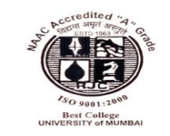
Virtualization
Hyper - V
Presented By : Sneha Pawar.
Roll No :- 11
Msc IT Part I Sem II
Msc IT Sem I – Part – II. Sub : Virtualization (Hyper -V) Sneha Pawar. Roll No : 11

Slide 2
Subtopics :
What is Virtualization ?
What is Cloud Computing ?
Virtualization in Cloud Computing.
What is Hypervisor ?
Types of Hypervisor.
What is Hyper – V ?
How to configure Hyper – V ?
Hyper – V Versions.
Hyper – V Features.
Msc IT Sem I – Part – II. Sub : Virtualization (Hyper -V) Sneha Pawar. Roll No : 11

Slide 3
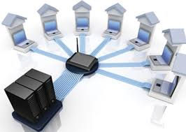
What is Virtualization ?
It is the technique of splitting the physical resource into as many as logical resources as we want.
Virtualization is the creation of a virtual (rather than actual) version of something, such as an Operating System (OS), a Server, a Storage Device or network resources.
Virtualization is a technology that transforms Hardware into Software.
Msc IT Sem I – Part – II. Sub : Virtualization (Hyper -V) Sneha Pawar. Roll No : 11

Slide 4
What is Cloud Computing :
Cloud computing means storing and accessing data and programs over the internet instead of your computer’s hard disk.
Virtualization in Cloud Computing :
Virtualization plays a very important role in cloud computing technology. Normally in cloud computing users access the data and programs over the internet, and the environment that is created to store each user’s data differently is achieved with the help of virtualization.
Msc IT Sem I – Part – II. Sub : Virtualization (Hyper -V) Sneha Pawar. Roll No : 11

Slide 5
What is Hypervisor ?
Hypervisor is a software or firmware that creates and run virtual machine.
Hypervisor is sometimes also called as a Virtual Machine Manager.
Msc IT Sem I – Part – II. Sub : Virtualization (Hyper -V) Sneha Pawar. Roll No : 11

Slide 6
Types of Hypervisors :
There are 2 types of Hypervisors.
1) Type – I (Also called as Bare Metal Hypervisor or Native Hypervisor)
2) Type – II (Also called as Hosted Hypervisor)
Msc IT Sem I – Part – II. Sub : Virtualization (Hyper -V) Sneha Pawar. Roll No : 11

Slide 7
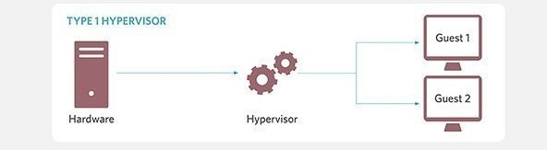
Type – I Hypervisor :
Examples of Type – I Hypervisor :
1) VMware ESXi
2) Citrix XenServer
3) Microsoft’s Hyper - V
Msc IT Sem I – Part – II. Sub : Virtualization (Hyper -V) Sneha Pawar. Roll No : 11

Slide 8
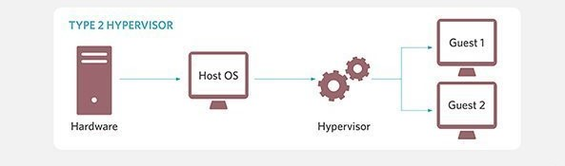
Type – II Hypervisor :
Examples of Type – II Hypervisor :
1) VMware Workstation
2) Oracle’s Virtual Box
3) Microsoft’s Virtual PC
Msc IT Sem I – Part – II. Sub : Virtualization (Hyper -V) Sneha Pawar. Roll No : 11

Slide 9
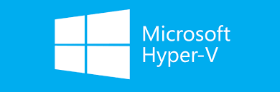
What is Hyper – V ?
Hyper – V is Microsoft’s Hardware Virtualization Product. It lets you create and run a software version of a computer, called a virtual machine.
Each virtual machine acts like a complete computer, running an operating system and programs.
It is a Microsoft technology that allows users to create virtual computer environments, and run and manage multiple operating systems on a single physical server.
Msc IT Sem I – Part – II. Sub : Virtualization (Hyper -V) Sneha Pawar. Roll No : 11

Slide 10
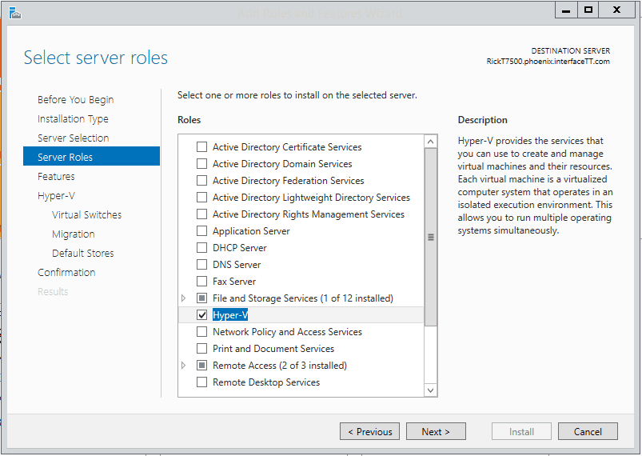
How to Configure Hyper – V ?
First we need to install windows server OS on server Hardware.
Then we need to add the Hyper –V role in that.
Msc IT Sem I – Part – II. Sub : Virtualization (Hyper -V) Sneha Pawar. Roll No : 11

Slide 11
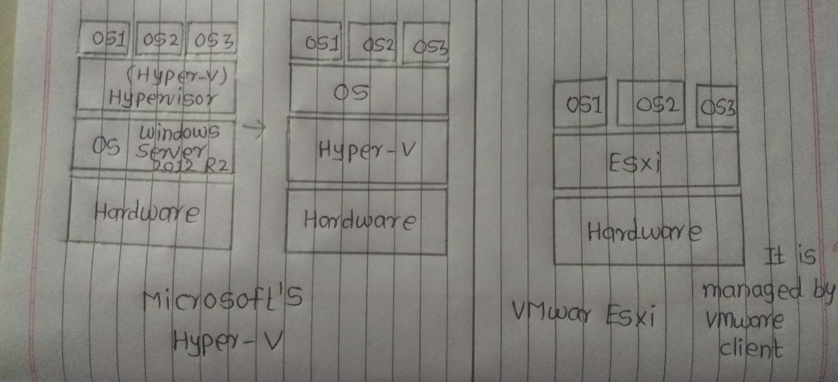
Msc IT Sem I – Part – II. Sub : Virtualization (Hyper -V) Sneha Pawar. Roll No : 11

Slide 12
Hyper – V is not actually installed on the host OS.
When you install Hyper – V you think it’s being installed on the top of a host OS but it is not actually true.
The setup converts the original OS in something like a VM and puts the hypervisor below.
Hyper – V consists of a hypervisor layer upon which there is a parent partition and possibly any number of child partitions are created by the host and contain guest operating systems which run alongside the parent partition.
Msc IT Sem I – Part – II. Sub : Virtualization (Hyper -V) Sneha Pawar. Roll No : 11

Slide 13
Hyper – V Versions :
There are 3 versions of Hyper – V available :
Hyper – V Server : A standalone product created for managing dedicated and virtual server instances.
Hyper – V for Windows 10 : A product you can run on your laptop or desktop.
Hyper – V for Windows Server : an add – on for Windows Server.
Msc IT Sem I – Part – II. Sub : Virtualization (Hyper -V) Sneha Pawar. Roll No : 11

Slide 14
Hyper – V Features :
Disaster recovery and backup
Portability
Remote Connectivity
Security
Msc IT Sem I – Part – II. Sub : Virtualization (Hyper -V) Sneha Pawar. Roll No : 11

Slide 15
Thank You !
Msc IT Sem I – Part – II. Sub : Virtualization (Hyper -V) Sneha Pawar. Roll No : 11

